Slide 1
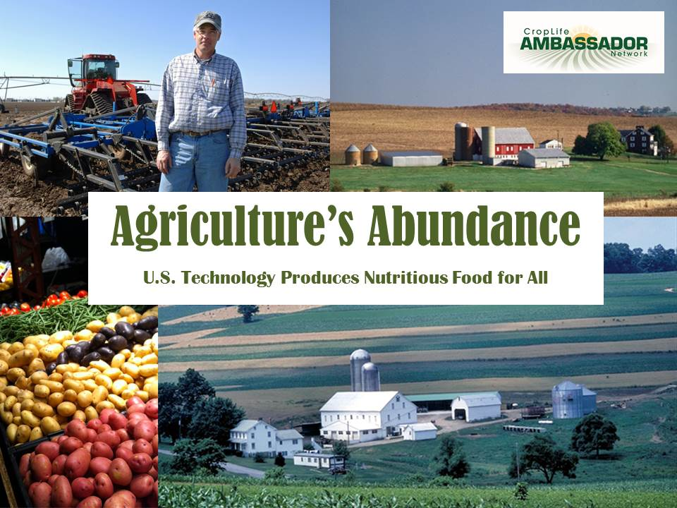
Notes:
Introduction:
My name is __________. I’m here to share with you my knowledge and experience in the business of producing the food that you eat.
Do you know what that business is called? (Let students try to answer). Some people call it farming, but it is also known as agriculture. (Share your background in agriculture.)

Slide 2
Notes:
Agriculture is defined as
ag·ri·cul·ture The science, art, and business of cultivating soil, producing crops, and raising livestock; farming.
Agriculture starts on the farm, but includes all the people and places who plant and harvest the farm crops, change them into forms we can use and get them to stores where we can buy them. So it’s the equipment factory, the trucking system, the scientist’s laboratory, and much more.
Do you think agriculture affects you?
Source:
http://www.thefreedictionary.com/agriculture

Slide 3
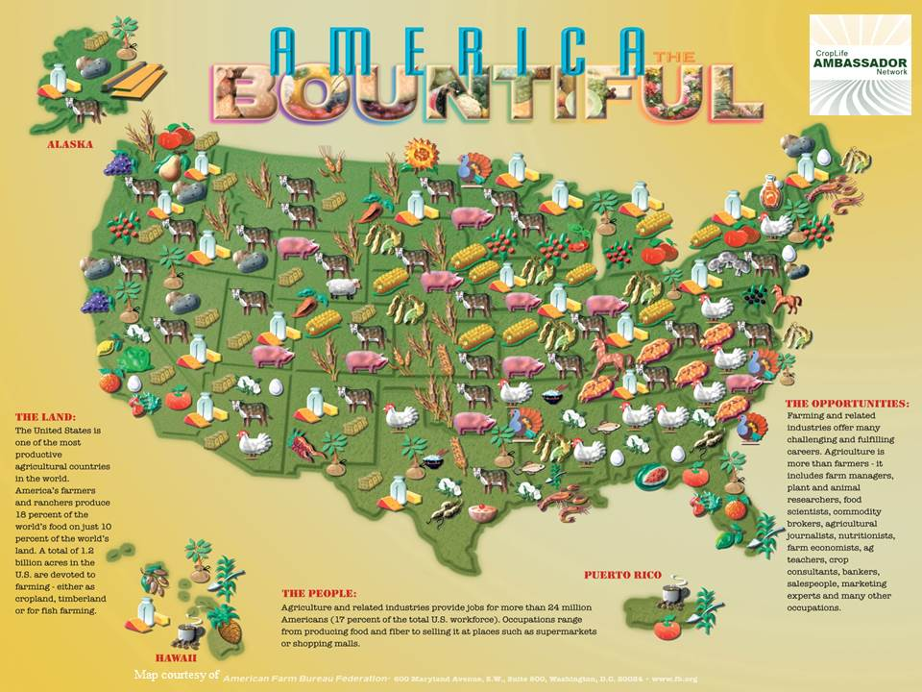
Map courtesy of
Notes:
The United States is one of the most productive agricultural countries in the world. Fifty-one percent of the United States is used for growing crops and raising livestock (cows, pigs, chickens, etc.).
Review map with students.
In the Midwest, farmers grow many types of crops. Corn, soybeans, wheat and hay are the most common. Why is that? What type of landform and climate do we have in the Midwest? Answer: The plains and rain.
SOURCES:
United States Department of Agriculture, Economic Research Services, Land Use, Land Value & Tenure. http://www.ers.usda.gov/topics/farm-economy/land-use,-land-value-tenure.aspx#
(Map courtesy of the American Farm Bureau Federation)

Slide 4
Notes:
What is a soybean? It is an edible seed called a legume. It is very high in protein and also a good source of oil. Who has ever eaten a soybean? You might not realize it, but everyone in here has probably eaten a soybean product. The US grows more soybeans than any other country in the world. Soy is becoming one of the most popular plant products because of its versatility– lots of things can be made using soybeans.
You may have heard of soy milk. Soy milk is used to make tofu, just like cow’s milk is used for cheese. There is also soy-based flour, a good option for people who have a gluten allergy that limits their consumption of wheat products. You can snack on soy nuts, which can be roasted, salted, honey-coated, and much more, just like peanuts. Soybeans are also used in biodiesel.
SOURCES:
Encyclopedia Britannica - http://www.britannica.com/EBchecked/topic/557184/soybean
Iowa State University, Soybean Extension and Research Program - http://extension.agron.iastate.edu/soybean/uses_soyproducts.html
North Carolina Soybean Producers Association, Inc. - http://www.ncsoy.org/ABOUT-SOYBEANS.aspx
http://vegetarian.about.com/od/glossary/g/Tofu.htm

Slide 5
Notes:
Here are some other products that contain soybeans: emollient in candy (keeps ingredients from separating), bread (keeps bread soft and fresh longer), soy milk, tofu, crayons, candles, ink, textiles (fabric-used to make clothes), cosmetics, animal feed, plastics, cookies, crackers and cereal. When crushed and pressed, soybeans produce an oil that is used in margarine, cooking oils, salad dressings, mayonnaise and many prepared foods.
Not pictured – disinfectants, fungicides, putty, waterproof cement, paint, soaps
85% of the world’s soybeans are processed, or "crushed," annually into soybean meal and oil.
Meal - 98% of the soybean meal that is crushed is further processed into animal feed
2 % is used to make soy flour and proteins.
Oil – 95% is consumed as edible oil;
5% is used for industrial products such as fatty acids, soaps and biodiesel.
SOURCES:
Iowa State University, Soybean Extension and Research Program - http://extension.agron.iastate.edu/soybean/uses_soyproducts.html
North Carolina Soybean Producers Association, Inc. - http://www.ncsoy.org/ABOUT-SOYBEANS.aspx
North Carolina Soybean Producers Association, Inc. - http://www.ncsoy.org/ABOUT-SOYBEANS/Uses-of-Soybeans.aspx
http://www.soyatech.com/soy_facts.htm

Slide 6
Notes:
Most corn you see growing in the Midwest is Grain Corn or Feed Corn, specifically dent corn. What you eat for dinner is called sweet corn. Sweet corn only accounts for approximately 1 percent of corn production in the United States. The other 99% is field corn. The primary use for field corn is grain which can be used for animal feed and food processing. Corn is 95.3% of all field grains produced in 2013/2014. So while soybeans are versatile, corn remains the most widely used crop.
Roughly half of the field corn crop is used for animal feed and about 10% is processed for food ingredients. In 2011, ethanol consumed 28% of the corn crop which is expected to grow to one-third of the crop over the next 10 years, according to the USDA forecast. And finally, about 20% of the corn is exported.
SOURCES:
http://www.sdcorn.org/page/Education/sub/Cornasfood
http://www.ers.usda.gov/topics/crops/corn/background.aspx#.Ue2TZm08yuY

Slide 7
Notes:
From the toothpaste you use in the morning to the book you read at bedtime, corn plays a part in nearly every aspect of our lives. Here are just a small group of items that come from corn.
Corn Products:
Sweeten drinks, jams, candies and cereals
Balance tartness in drinks and candies, provide the chewy constancy, and aide in keeping many of these products fresh after packaging
Ensures your toothpaste has a minty flavor and doesn’t get hard after you open it
Helps give paint its consistency and color
Appears in pet treats as a good food source with fiber and amino acids
Helps give your favorite jeans just the right color, feel and lasting strength
Helps the clean in dish soap be more effective and produce suds
In canned fruits and vegetables it helps preserve texture, color, aroma and vitamin content.
Improve the smooth feel of books, paper strength and color quality
In sauces and condiments corn is used to improve texture, flavor and consistency and to maintain quality in reduced-fat versions
Many corn products are used in medicines and vitamins
Plastics from corn products produce 68% less fossil fuels and generate up to 55% less greenhouse gas emissions than traditional plastics
Corn is the most widely used material for ethanol production
SOURCES:
Texas Corn Producers - http://www.texascorn.org/index.html
Corn Refiners Association - http://www.corn.org/

Slide 8
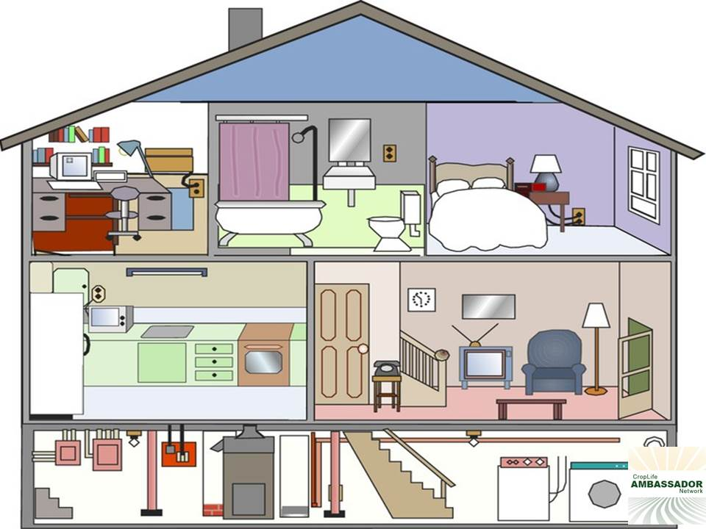
Notes:
Talk about a typical day and all the products that are used that come from agriculture.
When you woke up in your bed this morning, you already had your first meet-up with agriculture. Somewhere in your bedding and pajamas were materials made of fibers from cotton plants. Did you wash or shower with soap? That soap is made from fat from cattle and oil from plants such as palm, corn and soybeans. What did you eat for breakfast? Did you ride to school today? Tires on your bus, car or bike are made from the rubber plant. What items were a surprise to the students?
A World without Corn:
No frozen pizza: Corn starch is used as a barrier to keep water out of the crust so your pizza will have a crisp crust!
Frustrating wallpaper: Wallpaper paste is made with corn starch to slow down how fast it will adhere. You have more time to get the wallpaper on correctly.
Daily Bread Buying: Corn syrup prevents waste and saves consumers money by keeping bread fresh longer. The corn syrup holds moisture preventing baked goods from drying out too quickly.
No coloring for kids: Corn starch is used to help bind chalk together and to dust molds used to make crayons. The crayons will pop-out undamaged.
Corn chips are the most popular crunchy snacks.
Packing, storing and moving with corn: Corn starch provides the adhesive to glue down every little ridge in corrugated cardboard.
Want S’more? Not without corn! Marshmallows stay fresh longer because corn syrup keeps them from drying out too quickly. Corn ingredients are also used to make graham crackers.
What, no plaster board? Corn starch is an essential ingredient in making the gypsum or plaster boards for building walls.
SOURCE:
Iowa Corn Promotion Board/Iowa Corn Growers Association – http://www.iowacorn.org

Slide 9
Notes:
So is agriculture important to you? Think outside of yourself. How many people are in the world today? About 7 Billion.
Who knows what the word “POPULATION” means?
pop·u·la·tion : All of the people inhabiting a specified area. The total number of such people.
In other words, global population refers to the total number of people living on the Earth today. These days, the global population is growing at a very fast rate, which puts a tremendous strain on the Earth’s natural resources and its ability to produce enough food to feed us all. Already there are millions of people suffering from malnutrition (a lack of food) around the world and many of them die from starvation.
There are many reasons why this is happening. One of them is that many countries don’t have the agricultural technology that we have in the United States and are still growing food using the same techniques that we used more than 50 years ago. Although their population is growing, they are not growing enough food to feed all of the people.
That’s why technology is so important in the U.S. It allows us to grow plenty of food to feed ourselves and to export some as well. In turn, we try to share this technology with the countries that need it. Do you see why it’s so important to keep developing new technology in agriculture?
SOURCES:
Reverso Dictionary - http://dictionary.reverso.net/english-definition/population
Worldometers - http://www.worldometers.info/world-population

Slide 10
Notes:
This chart should give you an idea of how fast the global population is growing. As you can see, the population grew slowly between 1750 and 1950. But look how much growth we’ve experienced in the past 50 years alone! Unfortunately, most of this growth is taking place in underdeveloped countries, where they don’t have the technology to grow more food, as we do in America.
Take a look at this graph. You can see that from 1750 to 1950, the population grew steadily, but slowly…But since 1950, the population has nearly tripled! Scientists estimate that we will reach 10 billion before the year 2050.
The amazing fact is that even though we feed 3 times more people than we did 100 years ago, we use the exact amount of land as we did 100 years ago. This same amount of land will have to produce enough food to feed the additional 3-4 billion people expected in the next 40 years.
How can this be done?
SOURCE:
United Nations Population Division Reference Bureau - http://tinyurl.com/l76epkj

Slide 11
Notes:
The answer is TECHNOLOGY!
What do you think of when I say Technology? (discuss)
Merriam-Webster’s Dictionary defines technology as:
tech·nol·o·gy :
the practical application of knowledge especially in a particular area
In other words, technology is using scientific discoveries and inventions to solve problems.
It is important to understand how farmers grew our food in the past and the challenges farmers face to understand the technology we use today. You may be surprised at how much agriculture has changed over the past 100 years. Let’s take a look…….
SOURCE:
Merriam-Webster Dictionary - http://www.merriam-webster.com/dictionary/technology

Slide 12
Notes:
Although agriculture has been the worlds largest industry for thousands of years, let’s only go back a little over 100 years ago, to the beginning of the 1900s. Farmers didn’t have machines to help them grow food - nearly everything was done by hand. Because of this one farmer could only feed a limited number of people, usually just enough to feed their own family. This meant that almost half of the population were farmers.
Activity Option
So how many students do we have in this classroom today? (Have half the students in the classroom stand up so they can visualize the large number of people.) You would all be farmers. So how has this changed over the last 100 years.
30 years later in 1930, the number of farmers was down to 20% or 2 out of every 10 people. (do quick math and have 20% of the class stand up to help them visualize the change.)
Today, the number of farmers is down to 2% or 2 out of 100 people. In a group of 50 students only one of them would be a farmer.
So what does that mean about how much food 1 farmer produces? The number of people to feed isn’t going down, in fact it’s going up. The number of people one farmer feeds has increased from 10 in 1930 to 155 today.
100 years ago, technology involved improvements in farming tools and machines.
1930s: 1 acre produced 30 bushels of corn, Today: 1 acre = 120 bushels of corn (A bushel is the size of an average round laundry basket)given proper climate some farmers can produce 200+bushels
1930s – one farmer fed 10 people, today’s farmer feeds 155 people
1930s It took 15-20 hours of labor to produce 100 bushels of corn, Today: 2.75 hours of labor produces the same amount.
Exports. Because of new technology, today’s farmers produce more than enough food to feed the U.S. and have a lot left over. We export (sell to other countries) close to $100 Billion worth of ag products every year. Because we produce so much more food today, Americans have the safest, most abundant food supply in the whole world – and at very little cost. This is part of the reason that Americans are living healthier, longer lives.
The average life expectancy in the U.S. today is 78.5 years, up from 47 years in 1900.
Let’s take a look at how some things have changed over the years…
SOURCES:
Agriculture in the Classroom , “Growing a Nation, the Story of American Agriculture” - http://www.agclassroom.org/gan/timeline/farm_tech.htm
North Carolina Cooperative Extension – “Farmers Feed Us All” - http://lee.ces.ncsu.edu/2011/11/farmers-feed-us-all/
Centers for Disease control and Prevention - http://www.cdc.gov/nchs/fastats/lifexpec.htm
http://www.agweb.com/farmersfeedingtheworld/farming_matters.aspx

Slide 13
TILLING
Notes:
The soil must be prepared before planting can take place. Ancient agronomists (or farmers) used to break up the soil with sticks or hoes until the first “plow” was invented in 6,000 BC. Horses or mules were used to pull the early plows. Over the centuries, the ancient plow eventually developed into today’s plows (pictured) to turn the soil and prepare the land for planting seeds. This gets rid of the weeds that could crowd out the crop or compete with it for water and nutrients. There are three major categories of tillage methods: Conventional which uses a moldboard plow (pictured bottom left) and leaves minimal organic matter, Reduced Tillage which uses a chisel plow (pictured top left and right) and leaves 15-30% organic matter and Conservation Tillage leaving the most organic matter, at least 30%. The less the farmer tills and the more organic matter in the soil the less erodible the soil becomes and it holds more water. Herbicides may be used in all of these methods to kill weeds as well. The best time for tillage is just before planting (in order to minimize erosion) however, rainy spring weather can make it difficult to get equipment in the field as early as the farmers needs to optimize his yield.
Source:
www.epa.gov/agriculture/ag101/cropsoil.html
http://www.machine-history.com/The%20Plow

Slide 14
Notes:
After cultivating (turning) the soil, the farmer’s next step is to plant the seeds. Planting involves digging a straight line or trench, dropping the seeds at precise increments, then covering them up again with soil. Farmers used to have to dig individual holes, drop the seeds in by hand and cover them up again. Can you imagine how long it would take to plant a single acre (which is the size of a football field) of corn? What about thousands of acres, which is the size of some of today’s large farms.
With the invention of the tractor, planting became somewhat easier (the small picture to the right), but it still took a long time. Today’s planters can automatically plant many rows at a time at a much faster speed.
SOURCE:
http://www.epa.gov/agriculture/ag101/cropplanting.html

Slide 15
Notes:
From planting to harvest it may take 4 months before a crop is mature enough to harvest. In those four months the farmer faces a lot of challenges to produce a healthy crop. The main challenge are pests. Pests can be swarms of hungry insects, weeds and/or disease. Technology in the form of chemistry helps the farmer tackle these problems. Scientists have developed PESTICIDES. Pesticides are chemicals that farmers spray onto their crops that eliminate pesky bugs and worms, prevent weeds and disease.
Insecticides, fungicides and herbicides are all crop protection products. Insecticides are used to control insect pests. Fungicides deal with the fungi or moulds that affect seed germination, crop growth and the quality of the harvested produce. Herbicides control plant pests like chickweed, cleavers and blackgrass that rob the crop plant of light, water and food.
The Irish potato famine in the mid 1800’s was caused by a fungus that destroyed half of the potato crop in Ireland. Potatoes were such a major part of their diet that without them many people starved or had to leave Ireland due to lack of food. That fungus still exists today, but is kept under control through the use of fungicides.
Pesticides can be applied to fields or seeds before planting, to harvested produce or during processing, packing and transport. The very nature of these products make them toxic but only against the targets at which they are aimed. Modern crop protection products are specifically designed to be safe-not harmful to people that come into contact with them during manufacturing, application or at consumption of the food. They are to be specific, to only be effective against the diseases, insects and weeds they are aimed and short-lived after having the desired effect, they should break down easily into simple, harmless chemical components without harmful impact to the environment.
Today even with the help of pesticides 20-40% of crops are lost to pests. Without pesticides farmers could lose almost 3/4 of their crop.
PICTURE: Corn Borer (Center)
SOURCE:
http://www.ecpa.eu/page/what-pest
http://www.croplifeamerica.org/crop-protection/benefits/increase-food-production

Slide 16
Notes:
To help farmers use the most efficient amount and the best crop protection products possible, farmers use a technology that may look more like Star Trek than farming. It’s called “precision agriculture”, and is made possible by the use of Global Positioning Satellites (or GPS for short). Precision agriculture uses satellites in outer space to pinpoint locations on fields so information from these spots on fields can be recorded over time.
Using precision agriculture and GPS technology allows a farmer to be more productive and efficient. Farmers can pinpoint problems areas in crops for future management decisions and input recommendations. They can be more precise in pesticide application and better control the dispersion of those chemicals. Where farmers may once have treated an entire field uniformly, they are now seeing benefits of micromanaging their fields.
SOURCE:
http://www.gps.gov/applications/agriculture/
http://cropwatch.unl.edu/web/ssm/home

Slide 17
Notes:
Biotechnology is a very scientific sounding word - but it’s easy to figure out what it means if you look closely:
BIO means the study of LIVING THINGS
TECHNOLOGY, as we discussed, means new scientific discoveries used to solve problems.
So Biotechnology means – using scientific discoveries about living things to solve problems.
And that’s just what biotechnology is doing for agriculture right now. We’ve talked about the problems of global population and world hunger. Using Biotechnology, scientists are discovering new ways to solve these problems.
Here’s how:
Scientists have found a way to IDENTIFY genes that make crops healthy, strong and nutritious. Then they take these genes and insert them into other “baby” crop plants so that the baby crop plants can grow strong and produce healthy, nutritious foods in large amounts.
By using biotechnology in this way, scientists are helping American farmers grow more food on less land – which keeps the cost of food very low in the U.S.
Also, scientists are helping farmers in other countries grow healthy crops that produce lots of nutritious food which will help fight hunger and malnutrition among their people.
SOURCE:
Council for biotechnology Information -http://www.whybiotech.com/resources/factsheets_agbiotech.asp

Slide 18
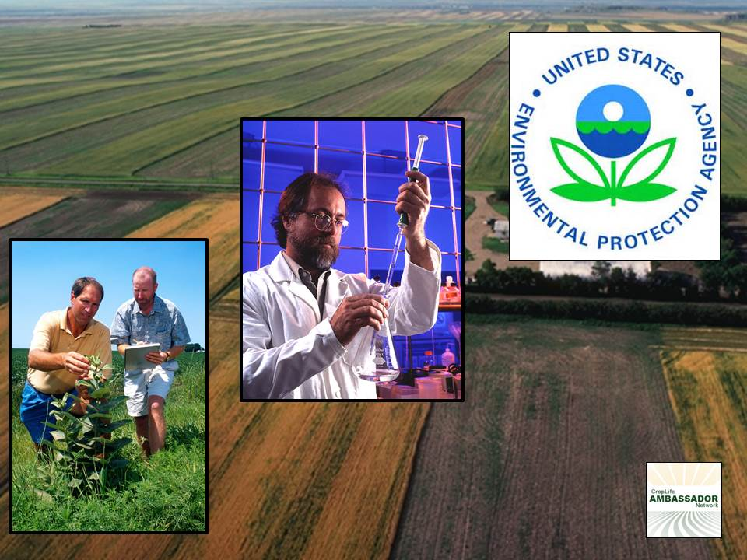
Notes:
Before a pesticide may be used on a food commodity, it must be approved for that use by EPA (Environmental Protection Agency) which is part of the US government that controls pesticide approval. Hundreds of tests are performed to determine that the product or its residues on foods will not present unreasonable risks to people, wildlife, fish, and plants. The EPA not only reviews and approves new pesticide products and uses before they come to market, but is systematically reviewing all older pesticides registered before November 1984 to ensure that they meet current testing and safety standards. In addition, the FQPA (Food Quality Protection Act) has a registration review program that will require all pesticides on the market to be evaluated at least every 15 years to ensure that they meet current safety standards. EPA has the authority to limit the amount of pesticide applied, restrict the frequency or location of application, or require the use of specially trained, certified applicators.
Source:
http://www.epa.gov/pesticides/factsheets/securty.htm

Slide 19
HARVESTING
Notes:
Once the crops are mature, they are harvested or picked. Harvesting crops involves getting the crop out of the field and transported to market. During the months of September – November, farmers are harvesting their crops as quickly as possible before the on-set of winter.
Crop Typical harvest period (in eastern corn belt)
Corn – grain October 7 to November 3
Corn - silage September 1 to October 15
Soybeans October 1 to October 20
Wheat (spring) August 14 to September 1
Wheat (winter) June 15 to July 15
Hay Usually 3 cuttings from May 15 to Sept. 30
The invention of the combine completely changed agriculture all together. The combines farmers use today are large machines that are literally food processing factories on wheels. With tires up to 14 feet tall (give example…almost three times as tall as most of you) and weighing more than 20,000 pounds (as much as 3 large elephants) the combine is able to cut the stalks, remove the grain and clean it while passing the refuge out the back. Harvesting crops used to be back-breaking work that took teams of farm workers and horses. What formerly required a crew of 15 large men and a team of 40 horses is now done by one machine and one operator. In fact, when the self-propelled combine was introduced in the 1950s, many people left the farms and moved to the cities to pursue other careers and lifestyles.
SOURCE:
http://www.epa.gov/agriculture/ag101/cropharvest.html

Slide 20
Notes:
Video actually starts at 32 seconds in

Slide 21
Notes:
But wait, once crops are harvested it doesn’t stop there. There is so much more before harvested crops get to you. Let’s take a look.

Slide 22
Notes:
On the farm agriculture requires big equipment and lots of it. That doesn’t stop after it leaves the farm.
Right in the fields crops are loaded on tractor trailers to be transported to a local grain elevator. At the grain elevators, the crops can be loaded onto barges and shipped down river for export (sold to other countries) or can be loaded onto rail cars for transportation to processors. Processors or manufactures are companies that turn the grain into the different products we’ve already talked about. Let’s follow a crop of soybeans.

Slide 23
Notes:
Soybeans are cleaned, dried, cracked, dehulled and heat tempered, then rolled into very thin flakes. The flakes are then pressed to extract the oil and the remaining “flakes” are ground into meal.
The crude oil has the lecithin removed and is then sent to an oil refinery. The oil is further processed and bottled to be used in salad and cooking oils, margarine or shortening.
Lecithin is added to food items to help smooth the texture in foods such as chocolate and margarine and makes instant foods easy to dissolve.
The flake or meal is processed to be used as a protein source for animal feed (major use), soy flour and soy protein concentrates. Which again are in many of the foods we already talked about.
SOURCE:
http://www.nsrl.uiuc.edu/aboutsoy/soyprocessing.html
http://www.soyinfocenter.com/HSS/soybean_crushing1.php

Slide 24
Notes:
Farms are bigger today than 70-100 years ago, but most are still family owned!
The highest number of farms the U.S. had was almost 7 million. Today, there are over 2 millions farms across the United States. 87% are still owned by families, 8% by partnerships, 4% corporately and 1% owned by other cooperatives. The number of women farmers has grown more than any other group of people.
Farmers use computers, the internet and GPS. Everyday they use science, business skills, and technical skills.
Even though we have fewer farms, the amount of land being farmed is almost the same as when we had 7 million farmers. That means each farm has gotten bigger. Technology has allowed us to grow enough food to feed 3 times the number of people we did in 1900 but on the same amount of land. This is so important because as our population continues to increase, we will not see any increase in the amount of land available to farm. In fact, it will probably decrease.
SOURCE:
http://www.epa.gov/agriculture/ag101/demographics.html

Slide 25
Notes:
The CropLife Ambassador Network is a program of Mid America CropLife Association. For more information please contact:
CropLife Ambassador Network: Ambassador.maca.org
800-625-2767
http://Mid America CropLife Association: www.maca.org
314-849-9446

