Slide 1
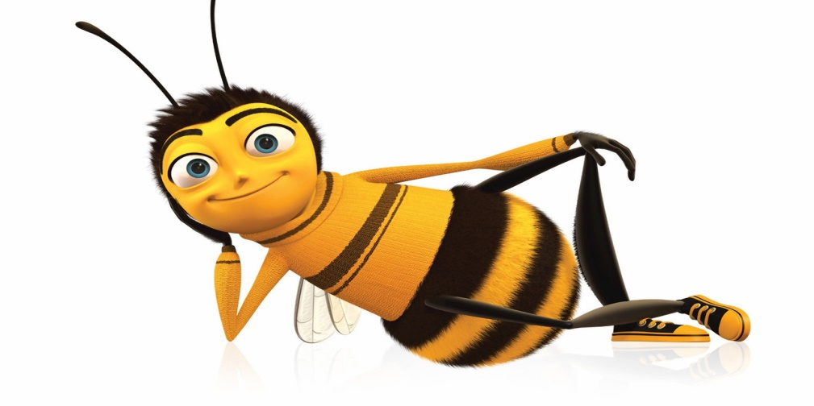
The Buzz about Bees
Notes:
“Hello class! Thank you for having me today. My name is __________ and I work at ___________ doing _______________. I’m excited to talk to you today about The Buzz about Bees!”
What do you guys know about bees?

Slide 2
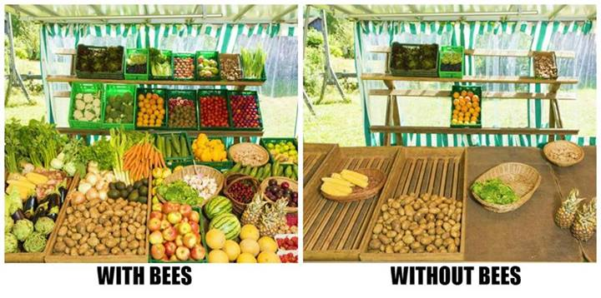
Why are honey bees important to us?
All fruits and vegetables need some form of pollination to reproduce.
The honey bee is one of the main pollinators.
For the past 20 years the honey bee population has decreased by 30-50% which is causing concerns.
Other pollinators are other bees, birds and bats, but honey bees are the most productive.
Notes:
What is your favorite fruit or vegetable? Thank a bee for helping grow that for you!

Slide 3
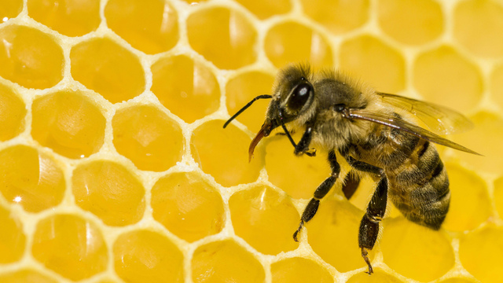
Fun Facts
Honey gives energy to bee flight muscles that beat 12,000 times per minute.
All bees require nectar and pollen from flowering plants as food for themselves and their offspring.
Bees drink nectar using a straw-like tongue called a probiscus. They are also equipped with branched (plumos) body hairs that can catch and hold pollen and combs (scopae) or baskets (corbiculae) for carrying pollen.

Slide 4
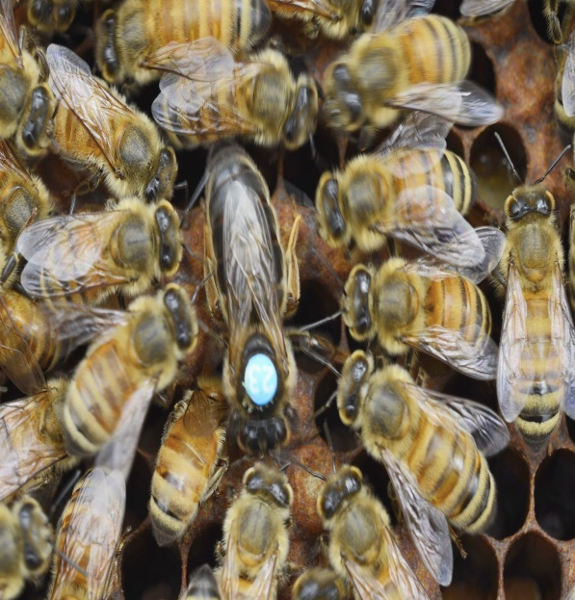
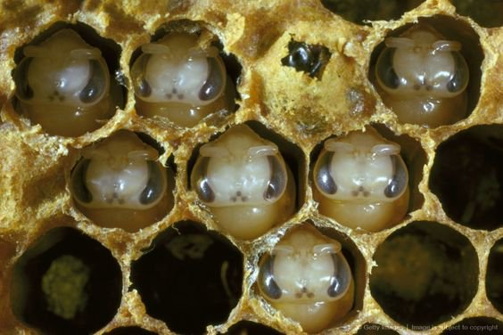
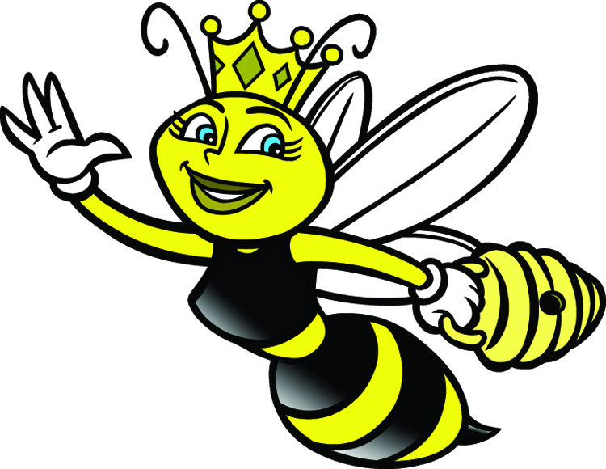
Fun Facts
Honey bees can visit up to 5,000 flowers in a single day.
Honey bees collect nectar and convert it to honey. The honey is regurgitated for storage OR mixed with pollen to feed developing larvae (the baby bees).
As the fertile female in the colony, the queen lays up to 2,000 eggs a day and can live for 1-3 years.
There are up to 60,000 female worker bees in each colony, whose life span is about 4-6 weeks in the summer.

Slide 5
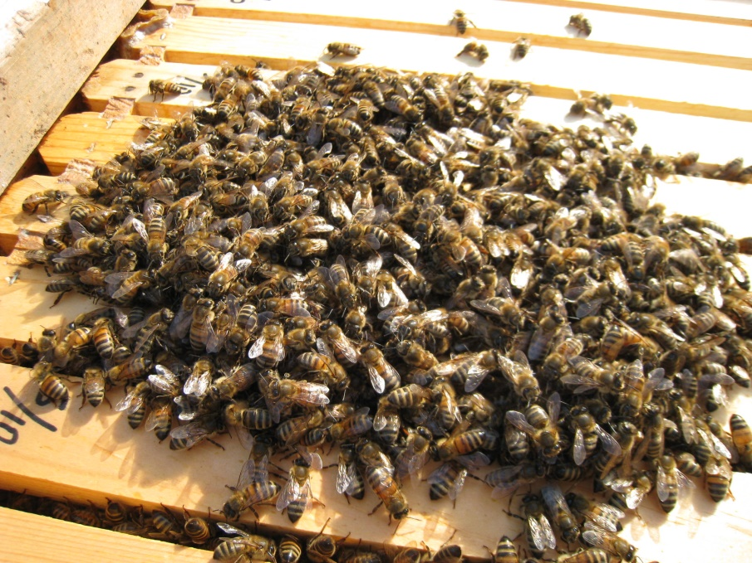
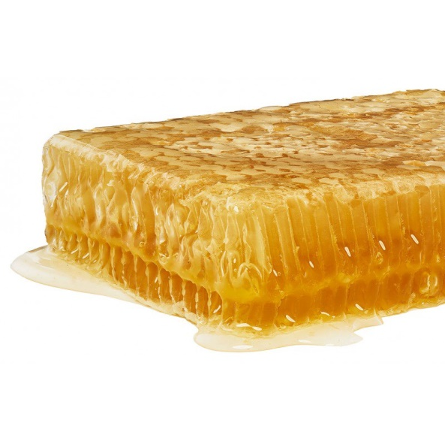
Fun Facts
In cold weather, the bees cluster together keeping the queen in the center nucleus and any developing bees warm. They generate body heat by vibrating their wing muscles and survive off the honey food reserves.
Honey bees secrete wax from their abdominal glands. They use the wax to build the honeycomb in the hive. The honeycomb cells are use to store pollen or honey, or as a place for the queen to lay eggs.
Bees must visit about two million flowers to make a one-pound jar of honey.

Slide 6
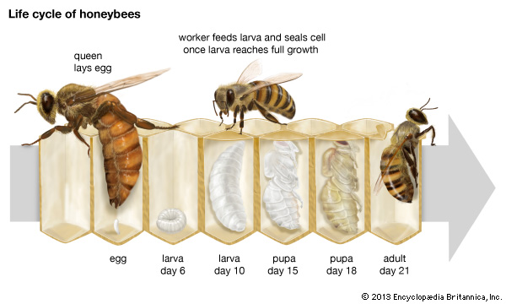
Notes:
VIDEO!
Like other insects a bee starts it's life as an egg. The queen bee lays an egg the size of half a grain of rice into a comb cell. After a few days it hatches into a larvae. The larvae now looks like a grain of rice with a mouth. Worker bees will visit up to 1,300 times a day to fed the larvae bee bread, a mix of nectar, bee pollen and a small amount of royal jelly. If the larvae is to be a queen it is fed solely on royal jelly. Within about 5-6 days the cell will be capped by a worker bee and the larvae will spin into a silk cocoon to then pupate. The pupae doesn't eat or move but takes the shape of a bee. About ten days later the adult bee emerges .
Quick 8 second video time lapse of egg becoming a bee: https://video.nationalgeographic.com/video/magazine/150415-ngm-bees - CLICK ON LIFE CYCLE OF HONEYBEES IMAGE TO PLAY VIDEO
https://www.sweetreehoney.co.nz/More+Info/The+Buzz+Blog/x_post/The-life-cycle-of-bees-00162.html

Slide 7
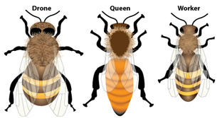
Meet the 3 Kinds of Honeybees
Notes:
Three different kinds of Honeybees – Drone, Queen and Worker bees

Slide 8
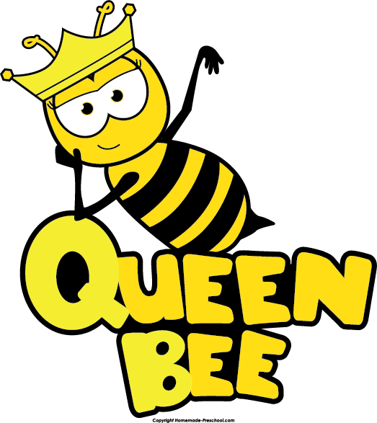
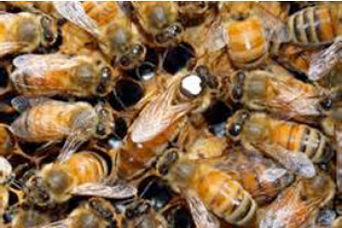
The Queen Bee
The honey bee queen is the largest of the bees in a honey bee colony.
As she establishes her colony, she may lay 1000 eggs per day – one egg every 20 seconds - and more than her own body weight in eggs!
The role of the queen honey bee is to mate with the drone bees (males), produce eggs (to create more bees) and to begin new colonies through swarming.
Honey bee queens live much longer than workers and drones.
If the queen performs well in the colony, she will probably live two or three years, but possibly as many as four or five.
Notes:
How Do Honey Bees Become Queens?
Despite the difference between herself and the female workers, what may surprise many is that she is produced from eggs that are in every way identical to those eggs producing workers. The difference, however, is that larvae of potential queens are fed only a special substance called ‘royal jelly’.
For the human eye, despite being larger than the workers, honey bee queens are difficult to spot among thousands and thousands of worker bees. For this reason, beekeepers mark queens with a dot of special paint on the thorax, as can be seen in the photograph above.
https://www.buzzaboutbees.net/honey-bee-queen.html
3 minute video of the birth of Maya the bee and meeting the queen bee: https://www.youtube.com/watch?v=GrCb9lT2DEw CLICK ON THE QUEEN BEE IMAGE ON THE SLIDE TO VIEW VIDEO

Slide 9
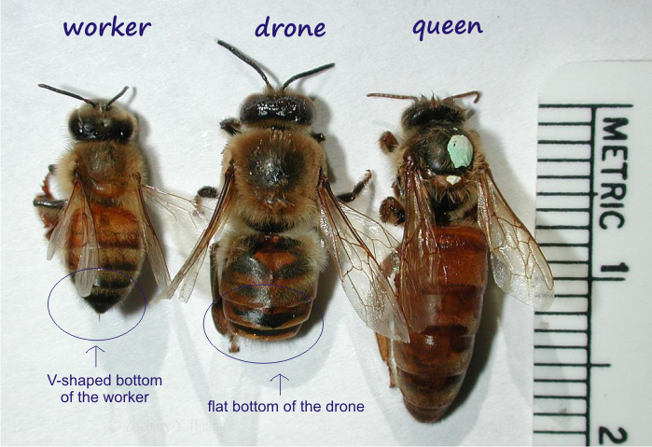
The Drone Bee
A drone is a male bee.
Unlike the female worker bee, drones do not have stingers.
Drone bees do not gather nectar and pollen.
A drone's primary role is to mate with a fertile queen.
They may live for just a few weeks or up to 4 months.
They die straight after mating!
It takes 24 days for the drone to develop from being an egg to a fully grown adult bee.
Drones are essential to the health and survival of future honey bee colonies.
Notes:
At the end of the summer, or when the going gets tough, they’re the first to be kicked out of the colony, so as not to drain resources.
Drones are fatherless.....yet they have a grandfather!
https://www.buzzaboutbees.net/dronebee.html

Slide 10
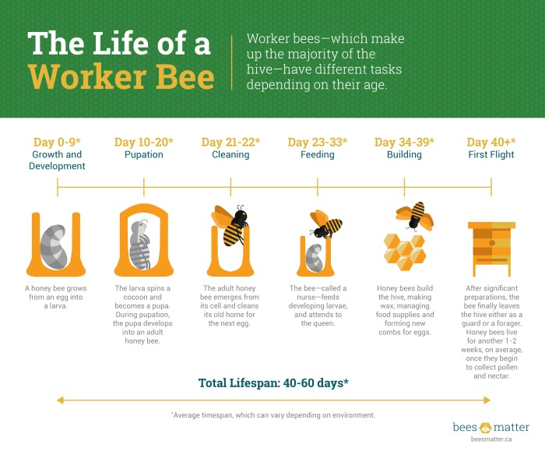
The Worker Bee

Slide 11
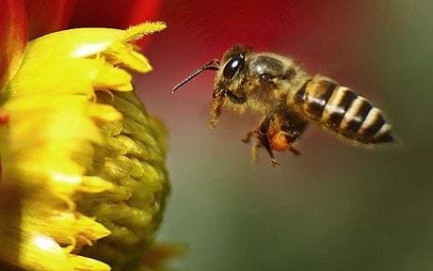
Worker Bee
Female bees.
Create the largest population of the hive.
Responsible for taking care of the young bees, food storage, cleaning, foraging, protection, tending to the queen and regulating the temperature of the hive.
Makes the wax to build the hive.
Lives for 5-8 weeks in the summer months. They can live longer during the winter months when there's less work to be done.

Slide 12
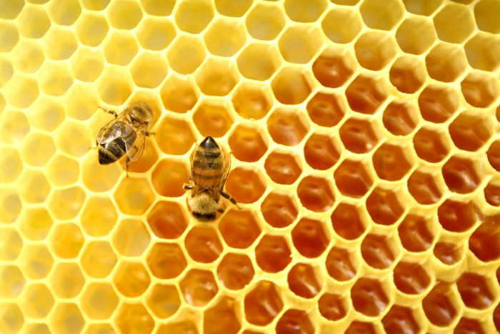
Honey Bee Hive
The honeybee hive is made of wax.
The perfect hexagonal cells are where the bees store larvae, pollen and honey.
The hive is the bees nursery, home and factory.
Notes:
Watch video on mute – Bayer Bee Center in North Carolina: https://www.facebook.com/MACroplifeA/videos/1642317062509622/

Slide 13
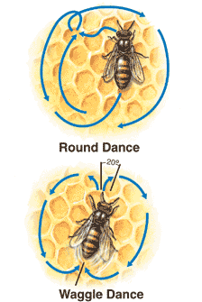
More Honey Bee Facts
Bees do a “bee dance” to communicate with other honey bees on where they can find the nectar or pollen.
For every pound of honey, around 25,000 flights were made to collect the necessary nectar. They also visited around 2 million followers to make that pound of honey and fly 55,000 miles.
Notes:
Maya the bee – dance of the bees cartoon: https://www.youtube.com/watch?v=YWQm8ryFMCM – CLICK ON THE IMAGE FOR THE VIDEO
See if you can have students try to do the dance.

Slide 14
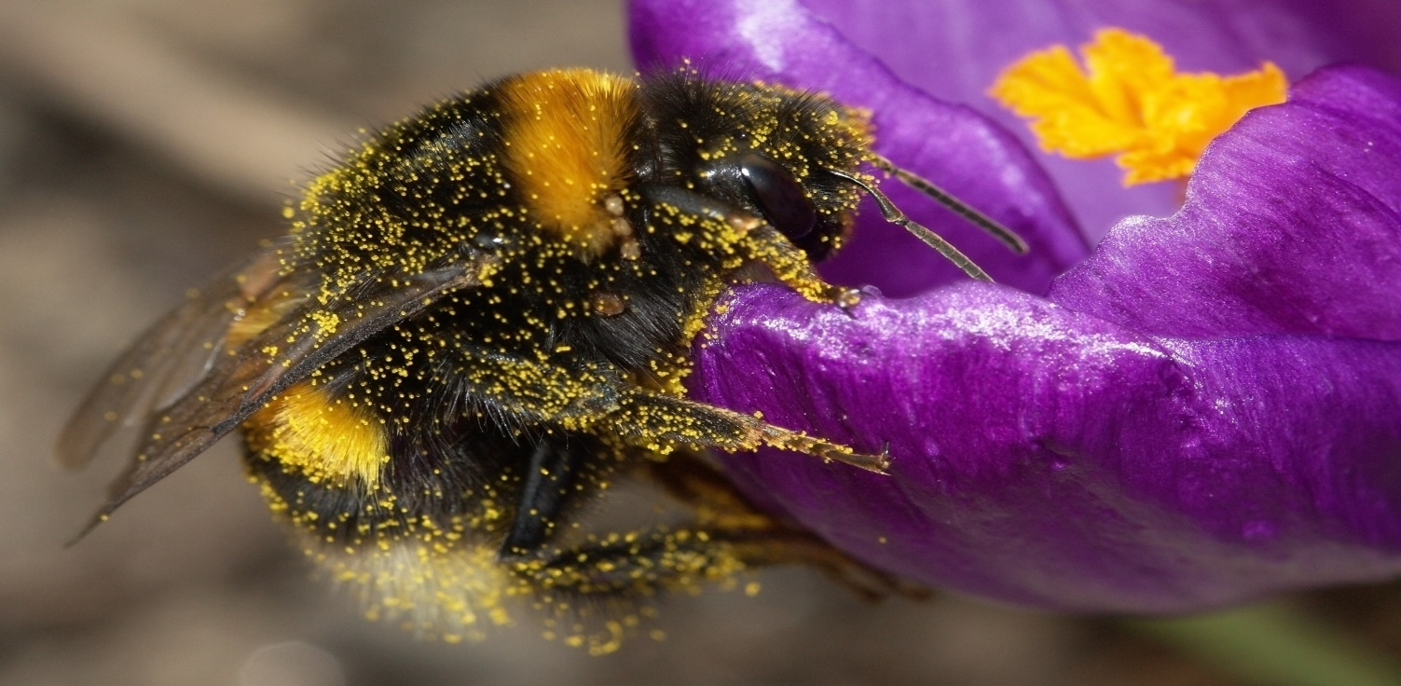
Pollination
Pollination is the transfer of pollen from one flower to another, which in turn lets the plant reproduce.
Honey bees fly to the flowers and collect pollen.
The honey bee then distributes pollen to the stigma of the female plants.
The stigma of the stile receives the pollen which initiates fertilization.

Slide 15
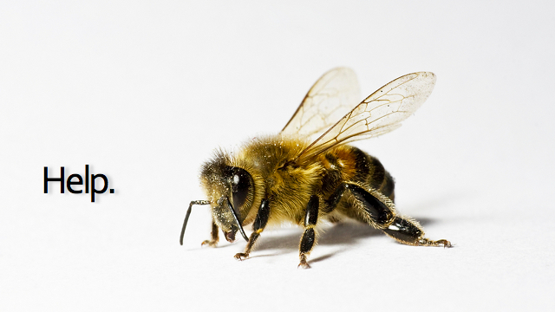
Colony Collapse
The recognizable fall of the bee population since 2006.
There is no single known cause for the fall. Some think it is due to stress on the bees.
Cell phones and power lines radiation are not the cause of the fall.
Almost every single bee keeper is reporting a loss.
Possible causes: Malnutrition and mites/viruses.

Slide 16
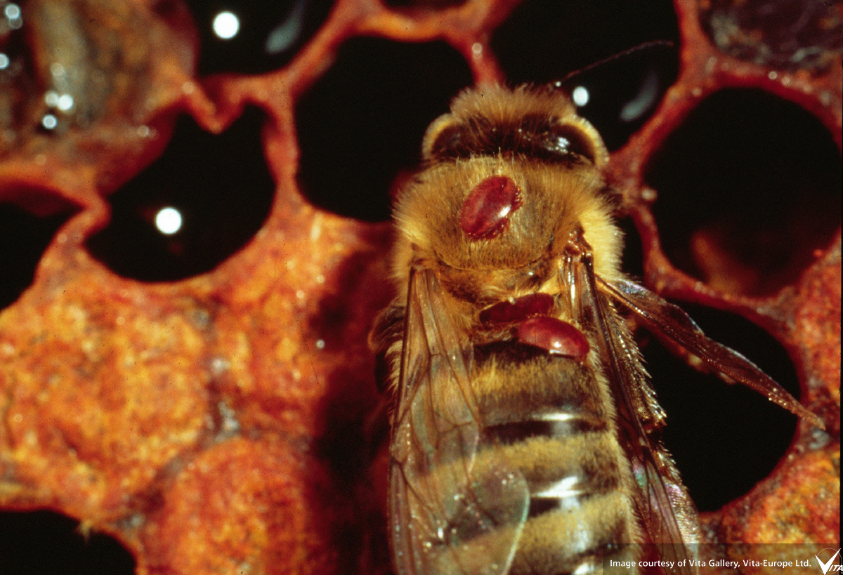
Malnutrition and Mites
Some honey bees are only pollinating a few crops through the year. This is called mono-cropping. This can cause bees to have an unhealthy diet due to not enough diversity to fight against sickness.
The biggest known killer of honey bees are the mites.
The Varroa mite infects and feeds on the larvae in the cells.
Nosema parasite infect the digestive tract of the bees.
Tracheal mites enter the breathing tubes of mature bees and choke them.
Varroa mites on a bee.

Slide 17
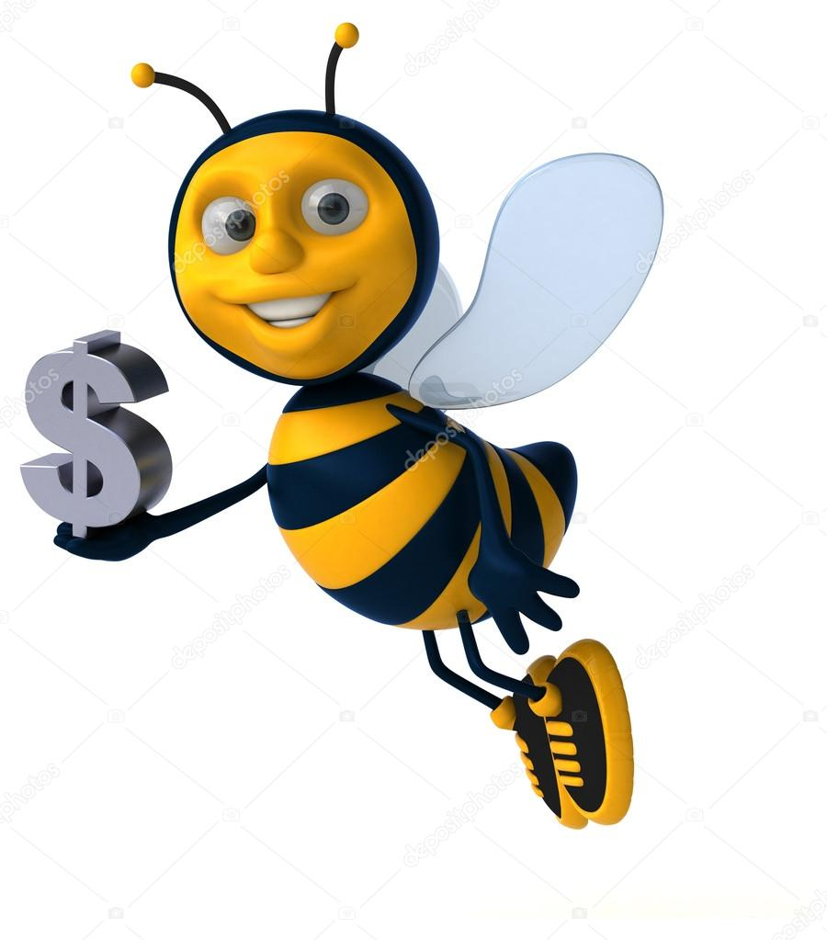
The Economics Behind Bees
About 1/3 of all the food we eat is pollinated by honey bees.
This represents $15 billion dollars of produce in the US annually.
If the honey bees die off, the price of all products will rise. Costs could triple or double in the next 20 years. For example, almonds went from $1.50 per pound in 1983 to $3.50 per pound in 2005.

Slide 18
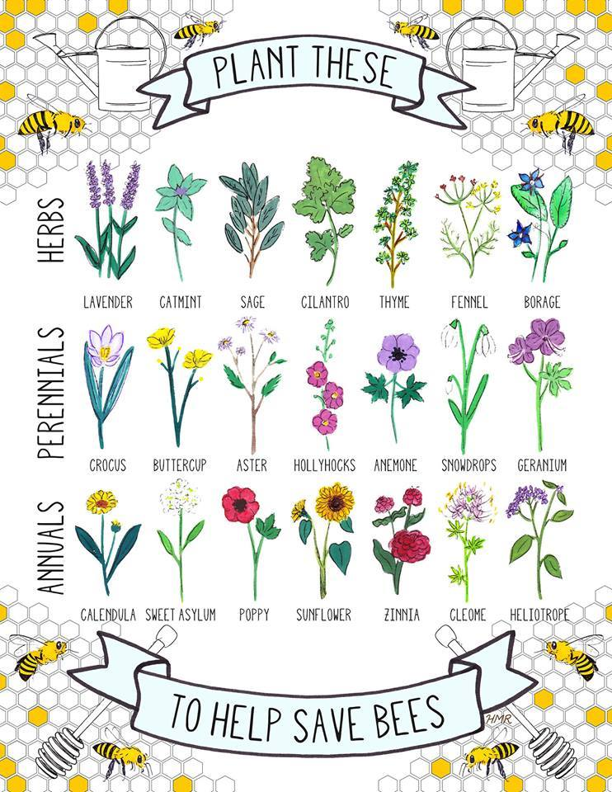
What you can do!
Plant flowers and plants in your yard that honey bees love!
Make your garden honey bee friendly.
Don’t kill bees.
Raise awareness.
Become a beekeeper.

Slide 19
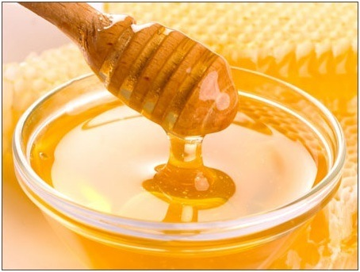
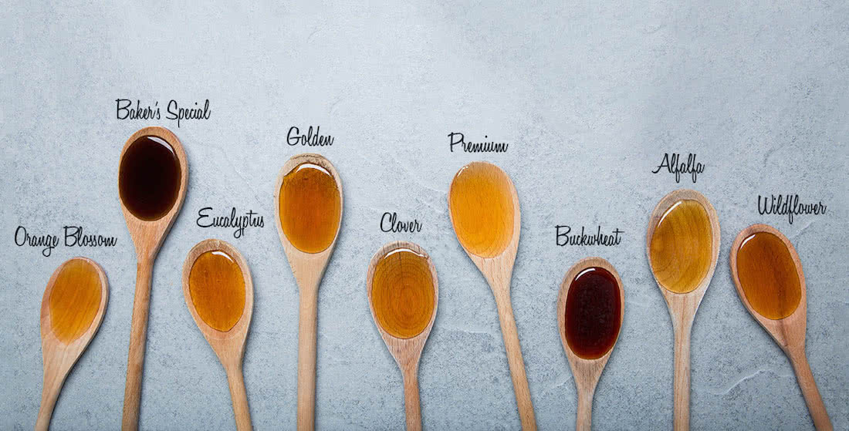
The best part of bees?
THE HONEY!
Honey is the only food that will not rot. It can remain edible in a jar for up to 3000 years.
It takes 8 bees all their life to make 1 teaspoon of honey.
Bees are the only insect in the world that makes food that people can eat.
Honey contains all of the substances needed to sustain life, including enzymes, water, minerals and vitamins.
Bees survive on honey in the winter months.
There can be different flavors and colors of honey depending on where the nectar comes from.
Honey is 80% sugars and 20% water.

Slide 20
Thank you!

